Slide 1
How
Long Short-Term Memory (LSTM) and
Recurrent Neural Networks (RNNs) work
Brandon Rohrer

Slide 2
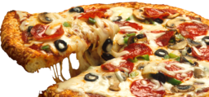
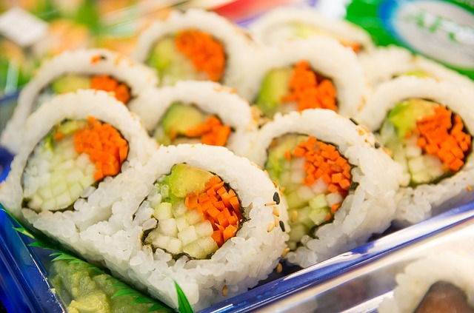
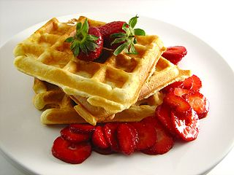
What’s for dinner?
day
of the week
pizza
month of the year
sushi
late meeting
waffles

Slide 3
What’s for dinner?
pizza yesterday
pizza
sushi yesterday
sushi
waffles yesterday
waffles

Slide 4
What’s for dinner?
predicted pizza for yesterday
pizza
predicted sushi for yesterday
predicted waffles for yesterday
sushi
pizza yesterday
sushi yesterday
waffles
waffles yesterday

Slide 5
A vector is a list of values
High temperature
67
Weather vector
67
Low temperature
43
“High is 67 F.
Low is 43 F.
Wind is 13 mph.
.25 inches of rain.
Relative humidity is 83%.”
=
=
43
Wind speed
13
13
.25
Precipitation
.25
.83
Humidity
.83

Slide 6
A vector is a list of values
Sunday
0
Day of week vector
Monday
0
0
0
=
Tuesday
1
=
1
“It’s Tuesday”
Wednesday
0
0
0
Thursday
0
0
Friday
0
0
Saturday
0

Slide 7
A vector is a list of values
Dinner prediction vector
0
Pizza
0
=
=
“Tonight I think we’re going to have sushi.”
1
1
Sushi
0
0
Waffles

Slide 8
predicted pizza for yesterday
pizza
predicted sushi for yesterday
predicted waffles for yesterday
sushi
pizza yesterday
sushi yesterday
waffles
waffles yesterday

Slide 9
prediction for today
predictions for yesterday
dinner yesterday

Slide 10
prediction
new information

Slide 11
prediction

Slide 12
Unrolled predictions
two days ago
yesterday
...
pizza
...
sushi
...
waffles

Slide 13
Write a children’s book
Doug saw Jane.
Jane saw Spot.
Spot saw Doug.
...
Your dictionary is small: {Doug, Jane, Spot, saw, .}

Slide 14
prediction
Jane
Doug
Spot
Jane
saw
Doug
.
Spot
Jane
saw
Doug
new information
Spot
.
saw
.

Slide 15
prediction
Jane
Doug
Spot
Jane
saw
Doug
.
Spot
Jane
saw
Doug
new information
Spot
.
saw
.

Slide 16
prediction
Jane
Doug
Spot
Jane
saw
Doug
.
Spot
Jane
saw
Doug
new information
Spot
.
saw
.

Slide 17
prediction
Jane
Doug
Spot
Jane
saw
Doug
.
Spot
Jane
saw
Doug
new information
Spot
.
saw
.

Slide 18
recurrent neural network
prediction
new information

Slide 19
Hyperbolic tangent (tanh) squashing function
1.0
.5
-2.0
-1.5
-1.0
-.5
.5
1.0
1.5
2.0
-.5
-1.0

Slide 20
tanh squashing function
1.0
.5
-2.0
-1.5
-1.0
-.5
.5
1.0
1.5
2.0
-.5
-1.0
Your number goes in here

Slide 21
tanh squashing function
1.0
.5
-2.0
-1.5
-1.0
-.5
.5
1.0
1.5
2.0
-.5
-1.0

Slide 22
tanh squashing function
The squashed version comes out here
1.0
.5
-2.0
-1.5
-1.0
-.5
.5
1.0
1.5
2.0
-.5
-1.0

Slide 23
tanh squashing function
1.0
.5
-2.0
-1.5
-1.0
-.5
.5
1.0
1.5
2.0
-.5
-1.0

Slide 24
tanh squashing function
1.0
.5
-2.0
-1.5
-1.0
-.5
.5
1.0
1.5
2.0
-.5
-1.0

Slide 25
tanh squashing function
No matter what you start with, the answer stays between -1 and 1.
1.0
.5
-2.0
-1.5
-1.0
-.5
.5
1.0
1.5
2.0
-.5
-1.0

Slide 26
recurrent neural network
prediction
new information

Slide 27
Mistakes an RNN can make
Doug saw Doug.
Jane saw Spot saw Doug saw …
Spot. Doug. Jane.

Slide 28
recurrent neural network
prediction
new information

Slide 29
recurrent neural network
prediction
new information

Slide 30
memory
prediction + memories
forgetting
memory
prediction
new information

Slide 31
Plus junction: element-by-element addition
3
4
3 + 6
9
5
=
=
4 + 7
11
6
5 + 8
13
7
8

Slide 32
Times junction: element-by-element multiplication
3
4
3 x 6
18
5
=
=
4 x 7
28
6
5 x 8
40
7
8

Slide 33
Gating
0.8
0.8
Signal
0.8 x 1.0
0.8
0.8
=
=
0.8 x 0.5
0.4
1.0
0.8 x 0.0
0.0
On / Off
gating
0.5
0.0

Slide 34
Logistic (sigmoid) squashing function
No matter what you start with, the answer stays between 0 and 1.
1.0
.5
-2.0
-1.0
1.0
2.0

Slide 35
memory
prediction and memories
forgetting
memory
prediction
new information

Slide 36
memory
prediction
selection
collected possibilities
forgetting
memory
new information
possibilities

Slide 37
long short-term memory
prediction
selection
collected possibilities
forgetting
memory
filtered possibilities
ignoring
new information
possibilities

Slide 38
long short-term memory
prediction
selection
collected possibilities
forgetting
memory
filtered possibilities
ignoring
Jane saw Spot.
Doug …
possibilities

Slide 39
long short-term memory
prediction
selection
Doug,
Jane,
Spot
collected possibilities
forgetting
memory
filtered possibilities
ignoring
Jane saw Spot.
Doug …
possibilities

Slide 40
long short-term memory
prediction
selection
Doug,
Jane,
Spot
collected possibilities
forgetting
memory
filtered possibilities
ignoring
Jane saw Spot.
Doug …
saw,
Doug

Slide 41
long short-term memory
prediction
selection
Doug,
Jane,
Spot
collected possibilities
forgetting
memory
saw,
Doug
ignoring
Jane saw Spot.
Doug …
saw,
Doug

Slide 42
long short-term memory
prediction
selection
Doug,
Jane,
Spot
saw,
Doug
forgetting
memory
saw,
Doug
ignoring
Jane saw Spot.
Doug …
saw,
Doug

Slide 43
long short-term memory
saw
selection
Doug,
Jane,
Spot
saw,
Doug
forgetting
memory
saw,
Doug
ignoring
Jane saw Spot.
Doug …
saw,
Doug

Slide 44
long short-term memory
prediction
selection
collected possibilities
forgetting
memory
filtered possibilities
ignoring
new information
possibilities

Slide 45
long short-term memory
prediction
selection
saw
collected possibilities
forgetting
memory
filtered possibilities
ignoring
new information
possibilities

Slide 46
long short-term memory
prediction
selection
saw
collected possibilities
forgetting
memory
filtered possibilities
ignoring
Jane saw Spot.
Doug saw …
possibilities

Slide 47
long short-term memory
prediction
selection
saw,
Doug
saw
collected possibilities
forgetting
memory
filtered possibilities
ignoring
Jane saw Spot.
Doug saw …
possibilities

Slide 48
long short-term memory
prediction
selection
saw,
Doug
saw
collected possibilities
forgetting
Doug
filtered possibilities
ignoring
Jane saw Spot.
Doug saw …
possibilities

Slide 49
long short-term memory
prediction
selection
saw,
Doug
saw
collected possibilities
forgetting
Doug
filtered possibilities
ignoring
Jane saw Spot.
Doug saw …
Doug,
Jane,
Spot

Slide 50
long short-term memory
prediction
selection
saw,
Doug
saw
collected possibilities
forgetting
Doug
Doug,
Jane,
Spot
ignoring
Jane saw Spot.
Doug saw …
Doug,
Jane,
Spot

Slide 51
long short-term memory
prediction
selection
saw,
Doug
saw
Jane,
Spot
forgetting
Doug
Doug,
Jane,
Spot
ignoring
Jane saw Spot.
Doug saw …
Doug,
Jane,
Spot

Slide 52
long short-term memory
Jane,
Spot
selection
saw,
Doug
saw
Jane,
Spot
forgetting
Doug
Doug,
Jane,
Spot
ignoring
Jane saw Spot.
Doug saw …
Doug,
Jane,
Spot

Slide 53
Sequential patterns
Text
Speech
Audio
Video
Physical processes
Anything embedded in time (almost everything)

Slide 54
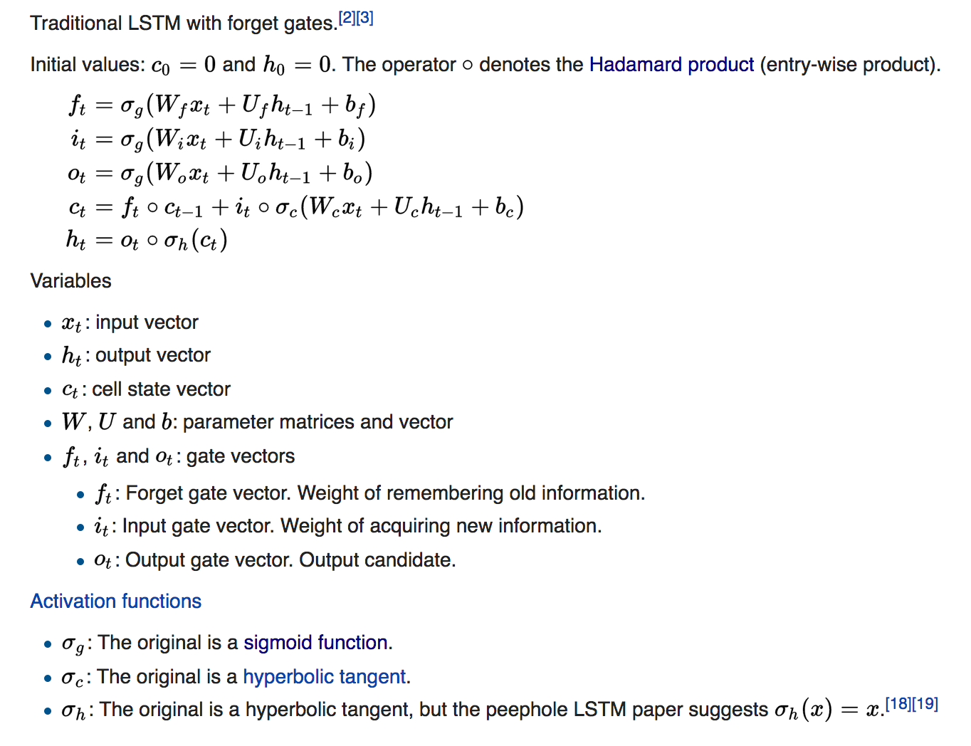

Slide 55
Resources
Chris Olah’s tutorial
Andrej Karpathy’s
Blog post
RNN code
Stanford CS231n lecture
The DeepLearning 4J tutorial has some helpful discussion and a longer list of good resources.
How Neural Networks Work [video]

Slide 56
Credits (all images CC0)
Pizza image
Sushi image
Waffles image

